Slide 1




Hunt The Wumpus
PRESENTED BY - SHIVAM KUMAR
SHIKHAR PANDEY
El Clasico

Slide 2

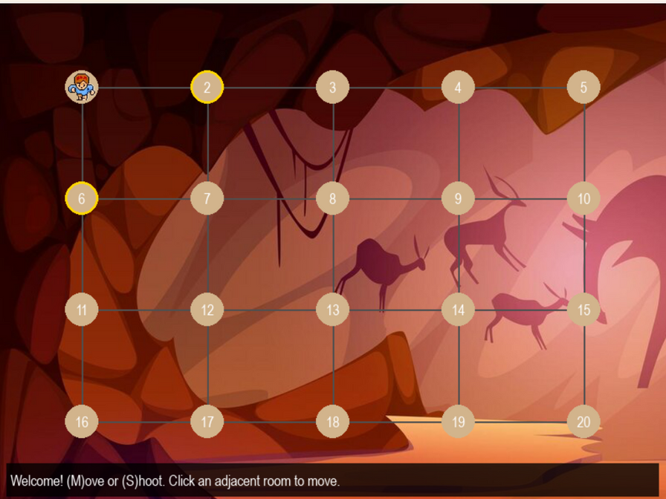
What’s Inside the Game ?
Game Overview
The game is set on a 4×5 grid where the player starts at room 1.
The objective is to hunt and kill the Wumpus using arrows while avoiding dangers.
The player has 2 arrows at the start but can find extra arrows while exploring.

Slide 3


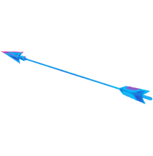

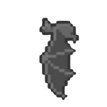
The Key Elements
Player: Starts at room 1 and explores the grid.
Wumpus: A creature that must be eliminated.
Arrows: Used to shoot and kill the Wumpus.
Pit: Falling into a pit means game over.
Bats: Move the player to a random position

Slide 4

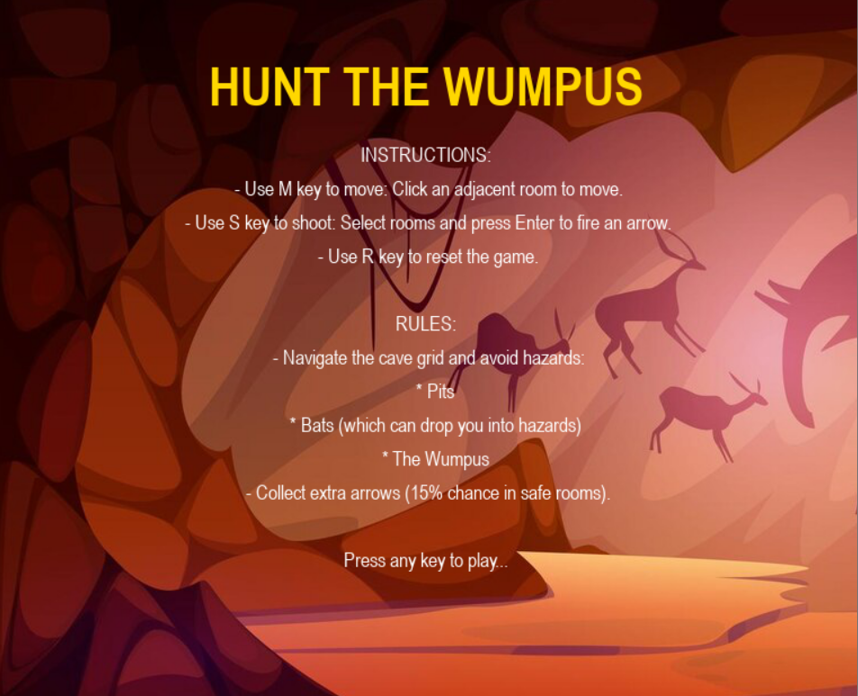
HOW TO PLAY GAME
Controls:
M Key – Move to an adjacent room.
S Key – Shoot an arrow (select a room and press Enter).
R Key – Reset the game.
Rules:
Avoid pits, bats, and the Wumpus.
Bats can relocate you to a random room.
Windy rooms indicate a nearby pit.
Flappy sounds mean a bat is close.
Stinky smell signals the Wumpus is near.
Find extra arrows (15% chance in safe rooms).

Slide 5

Play Like an AI
Pattern Recognition – Identify sensory cues:
Wind indicates a nearby pit.
Flapping sounds suggest a bat is nearby.
A foul smell means the Wumpus is close.
Decision Trees – Plan moves logically:
If a room smells bad, consider shooting an arrow.
If a room is windy, avoid it since a pit might be nearby.
Probabilistic Thinking – Predict the Wumpus's location:
Analyze clues carefully and only shoot when confident of its position.
Optimization & Risk Management – Maximize survival:
Take the safest paths, conserve arrows, and minimize unnecessary risks.

